Slide 1
Logic Families

Slide 2
Lecture 29 Gate Characteristics
Lecture delivered by:
Deepak V.

Slide 3
Objectives
At the end of this lecture, student will be able to:
Acquire the knowledge of logic device pin-outs
Explain gate characteristics
Describe transistors as switches

Slide 4
Topics
Gate Characteristics
Electrical Characteristics
Power Dissipation
Noise Margin

Slide 5
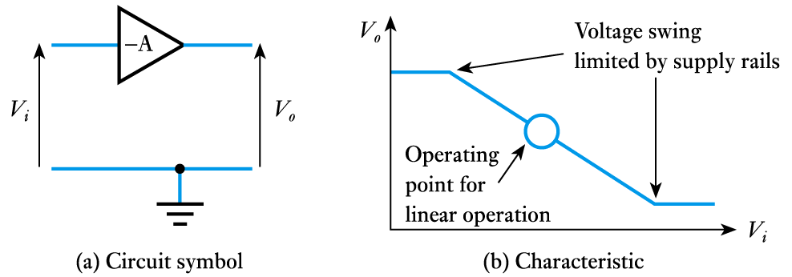
Gate Characteristics
The inverter or NOT gate
consider the characteristics of a simple inverting amplifier as shown below
we normally use only the linear region

Slide 6
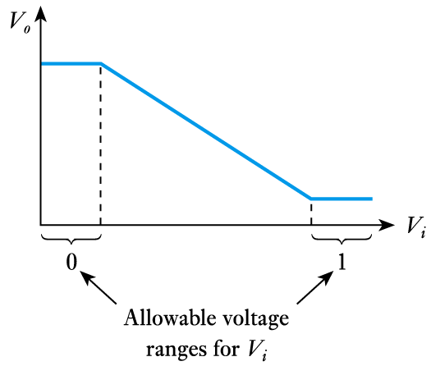
Gate Characteristics
An inverting amplifier cab be used as a logical inverter but using only the non-linear region

Slide 7
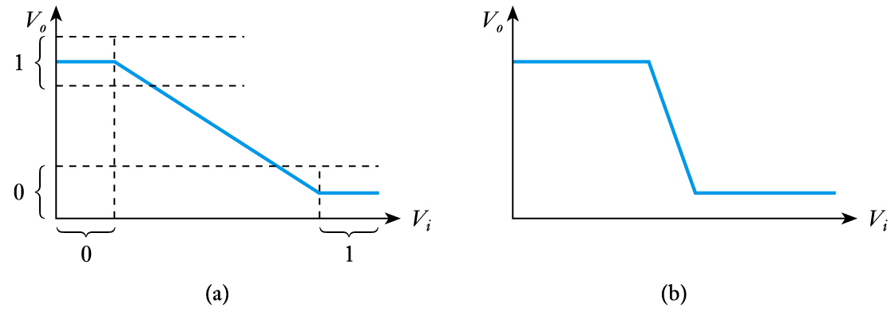
Gate Characteristics
An input values is choose to ensure that we are always outside of the linear region – as in (a)
Unlike linear amplifiers, the circuits is used with a rapid transition between the non-linear regions – as in (b)

Slide 8
Characteristics: TTL and MOS
Remember:
TTL stands for Transistor-Transistor Logic
uses BJTs
MOS stands for Metal Oxide Semiconductor
uses FETs
MOS can be classified into three sub-families:
PMOS (P-channel)
NMOS (N-channel)
CMOS (Complementary MOS, most common)

Slide 9
Electrical Characteristics
The characteristics of digital logic families are usually compared by analyzing the circuit of the basic gate in each family
The most important parameters are:
Fan-out specifies the number of standard loads that the output can drive without impairing its normal operation.
A standard load is usually defined as the amount of current needed by an input of another similar gate of the same family.
Power dissipation is the power consumed by the gate
Propagation delay is the average transition delay time for the signal to propagate from input to output
Noise margin is the minimum external noise vo,ltage that causes an undesirable change in the circuit output

Slide 10
Power Dissipation
Static
I²R losses due to passive components, no input signal
Dynamic
I²R losses due to charging and discharging capacitances through resistances, due to input signal

Slide 11
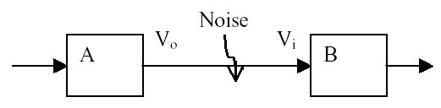
Noise Margin
Manufacturers specify voltage limits to represent the logical 0 or 1
These limits are not the same at the input and output sides
For example, a particular Gate A may output a voltage of 4.8V when it is supposed to output a HIGH but, at its input side, it can take a voltage of 3V as HIGH
In this way, if any noise should corrupt the signal, there is some margin for error

Slide 12
Noise Margin
If noise in the circuit is high enough it can push a logic 0 up or drop a logic 1 down into the indeterminate or “illegal” region
The magnitude of the voltage required to reach this level is the noise margin
Noise margin for logic high is:
N_{MH} = V_{OHmin} – V_{IHmin}
logic 1
V_{OHmin}
V_{IHmin}
V_{ILmax}
V_{OLmax}
indeterminate
input voltage
logic 0

Slide 13
Noise Margin
Difference between the worst case output voltage of one stage and worst case input voltage of next stage
Greater the difference, the more unwanted signal that can be added without causing incorrect gate operation
NM_{high} = V_{OHmin} - V_{IHmin}
NM_{low} = V_{ILmax} - V_{OLmax}

Slide 14
Noise Margin & Noise Immunity
Noise immunity of a logic circuit refers to the circuit’s ability to tolerate noise voltages on its inputs.
A quantitative measure of noise immunity is called noise margin
High Level Noise Margin, V_{NH} = V_{OH} (min) - V_{IH} (min)
Low Level Noise Margin, V_{NL} = V_{IL} (max) - V_{OL} (max)
Logic 1
Logic 1
VOH (min)
VNH
VIH (min)
VIL (max)
VNL
VOL (max)
Logic 0
Logic 0
Output Voltage Ranges
Input Voltage Ranges

Slide 15
Further Important Characteristics
The propagation delay (t_{pd}) which is the time taken for a change at the input to appear at the output
The fan-out, which is the maximum number of inputs that can be driven successfully to either logic level before the output becomes invalid

Slide 16
Speed: Rise & Fall Times
Rise Time
Time from 10% to 90% of signal, Low to High
Fall Time
Time from 90% to 10% of signal, High to Low
rise time
fall time
10%
90%
90%
10%

Slide 17
Speed: Propagation Delay
A logic gate always takes some time to change states
t_{PLH} is the delay time before output changes from low to high
t_{PHL} is the delay time before output changes from high to low
both t_{PLH} & t_{PHL} are measured between the 50% points on the input and output transitions
Input
50%
0
Output
0
tPHL
tPLH

Slide 18
Speed-Power Product
Speed (propagation delay) and power consumption are the two most important performance parameters of a digital IC.
A simple means for measuring and comparing the overall performance of an IC family is the speed-power product (the smaller, the better).
For example, an IC has
an average propagation delay of 10 ns
an average power dissipation of 5 mW
the speed-power product = (10 ns) x (5 mW)
= 50 picoJoules (pJ)

Slide 19
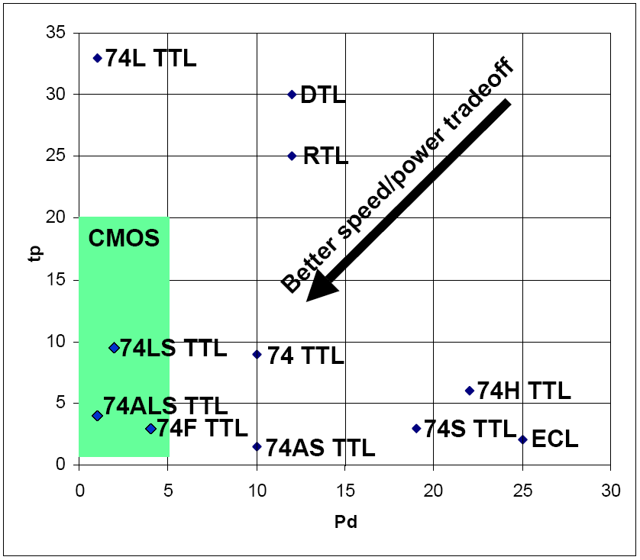
Logic Family Tradeoffs
Looking for the best speed/power product
t_{p} and Pd are normally included in the data sheet for each device
Older logic families are the worst
CMOS is one of the best
FPGAs use CMOS

Slide 20
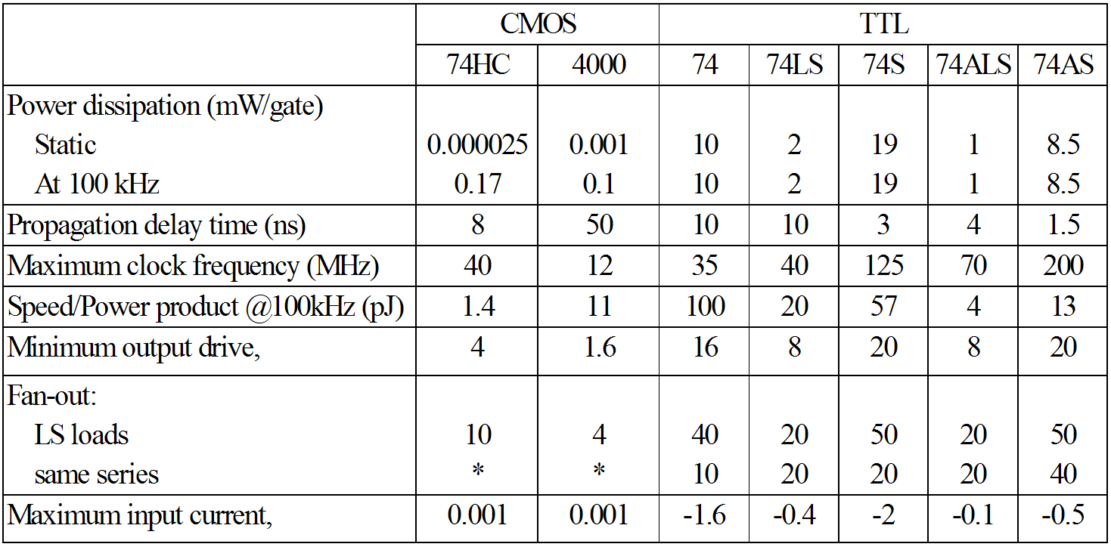
Comparison of Logic Families

Slide 21
Summary
An inverting amplifier cab be used as a logical inverter but using only the non-linear region
An input values is choosen to ensure that we are always outside of the linear region
Unlike linear amplifiers, the circuits is used with a rapid transition between the non-linear regions
The propagation delay (t_{pd}) which is the time taken for a change at the input to appear at the output

